Slide 1

Lab in Data Science
Final project presenstation
22.06.2018
Dream Team
Xingce Bao, Sohyeong Kim,
Guilio Masinelli, Silvio Zanoli

Slide 2
Problem Motivation
Develop an algorithm that can build a isochrone map with risk factors, and also a routing algorithm with the distribution of arriving time

Slide 3
Data preprocessing
BFKOORD_GEO
10km within Zürich HB
train_station_id.csv
istdaten
Filtering valid journeys
Add columns of unique_id for each journeys
Remove duplicated data
Separate the data by days
Remove the data if actual time is missing
Calculate mean and variance of each journey
Preprocessed data
(Mon to Sun)
Find the number of lines in each station
Choose the station which has more than 1 line.
transfer.p

Slide 4
'Bus' and 'Tram' we can simply count the distinct line_id
'Bus' and 'Tram' we can simply count the distinct line_id
Filtering valid journey
- ZUSATZFAHRT_TF = False ➔ Regular trip - FAELLT_AUS_TF = False ➔ Successful trip - DURCHFAHRT_TF = False ➔ Trip which stops at the station - AB_PROGNOSE_STATUS != UNBEKANNT ➔ Actual time of departure is recorded - AN_PROGNOSE_STATUS != UNBEKANNT ➔ Actual time of arriving is recorded
Calculate Mean and variance of each journey
Count the time of a day in seconds.
Ex) '02.04.2018 07:33' will be considered as '27180'seconds.
The gamma distribution ➔ shape parameter k and a scale parameter θ.
If variance explodes, we simply discarded that data.
Add columns
unique_id = the concatenate of the transport_id and station_id
Ex) 85:849:115493-03080-1:8591036
line_id = the concatenate of the transport_type, train_number and train_type
Ex) Bus:85:838:961:961
Find the number of lines in each station
Bus and Tram: used line_id
Train : used train_type.
Manually checked for the train type IR, IC, RE and e.t.c.
In total, there were 894 bus stations, 197 tram stations and 56 train stations.
331 stations has only one line of public transportation.
Remove duplicated data
unique_id | line_id | train_type | station_name | station_id | arriving_time_scheduled | arriving_time_actual | departing_time_scheduled | departing_time_actual
85:849:85817-02033-1:8591203 | Bus:85:849:033:33 | 33 | Zürich, Hubertus | 8591203 | 11.12.2017 20:32 | 11.12.2017 20:33 | 11.12.2017 20:32 | 11.12.2017 20:33
85:849:85817-02033-1:8591203 | Bus:85:849:033:33 | 33 | Zürich, Hubertus | 8591203 |  |  | 11.12.2017 20:32 | 11.12.2017 20:32
85:849:85817-02033-1:8591203 | Bus:85:849:033:33 | 33 | Zürich, Hubertus | 8591203 | 11.12.2017 20:33 | 11.12.2017 20:34
85:849:85817-02033-1:8591203 | Bus:85:849:033:33 | 33 | Zürich, Hubertus | 8591203 | 11.12.2017 20:32 | 11.12.2017 20:33 | 11.12.2017 20:32 | 11.12.2017 20:33
85:849:85817-02033-1:8591203 | Bus:85:849:033:33 | 33 | Zürich, Hubertus | 8591203 | 11.12.2017 20:33 | 11.12.2017 20:34 | 11.12.2017 20:33 | 11.12.2017 20:35

Slide 5
Connection adjacency matrix
 | EPFL | Renens Gare Sud | Renens | Lausanne Flon
EPFL | 1e9 | 1e9 | 10 | 10
Renens Gare Sud | 1e9 | 1e9 | 1 | 1e9
Renens | 10 | 1 | 1e9 | 10
Lausanne Flon | 10 | 1e9 | 10 | 1e9
Train Number | Station | Arrival Time | Departure Time
m1:10010 | EPFL | 12.00 | 12.00
m1:10010 | Renens | 11.50 | 11.55

Slide 6
Find all possible station list
Departure → Transfer or Destination
Departure → Transfer → Transfer or Destination
Renens → EPFL
Renens → St-Sulpice VD, Bochet → Walk
But no transfer more than 4!

Slide 7
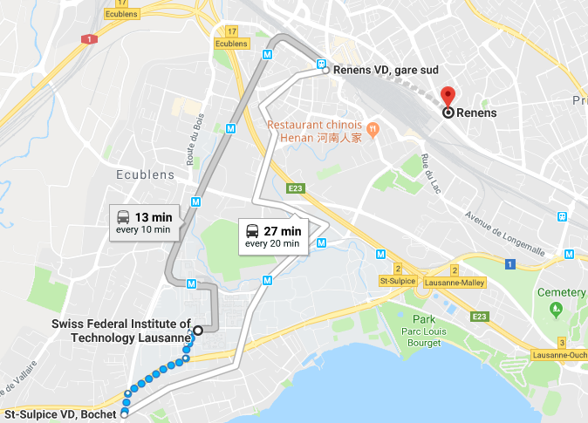
Renens to EPFL

Slide 8
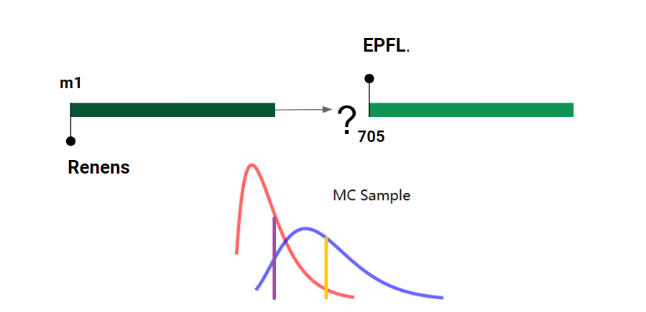
Can I catch the train?

Slide 9
Isochrone map
What is an isochrone map
Main building blocks
Combination of the building blocks

Slide 10
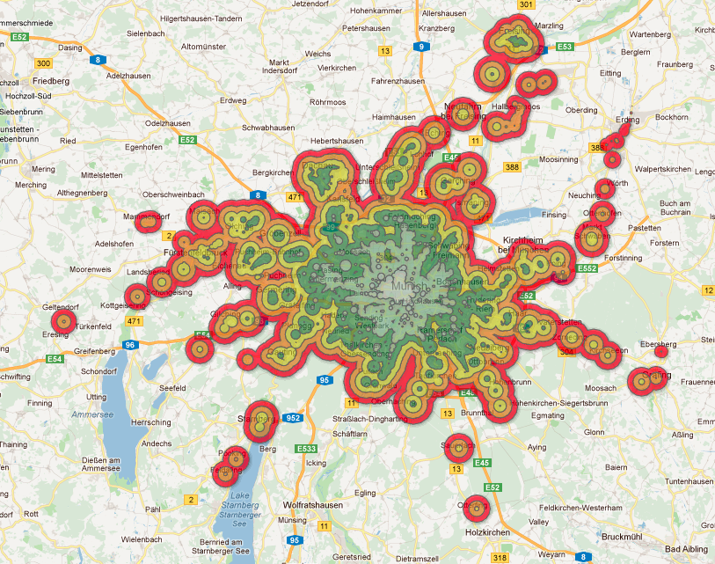
Isochrone map
What’s an isochrone map?:
A map that show where one can reach within a certain amount of time
Rarely implemented for public transport
We found no implementation of stochastic public transport isochrone map
Result will be shown in the next paragraph of this presentation

Slide 11
Main building blocks
Find neighboring stations
Find all train in a station
Find all the stops along one line
Distribution of the delay for the triad station-time-train
Compute the probability P(X<x)
Compute the probability P(X<Y)

Slide 12
Combination of the building blocks
At first we find all train we can catch from the chosen station (neighbor station and train in a station)
We add them to a FIFO
We search all the reachable stations with the train we found within the limit given [P(X<x)]
For all the reachable station, we add them to a FIFO and search for all the possible catchable train,
making a change [P(X<Y)]
Repeat recursively until we can find no more train to change to or direct line that satisfy time or probability
constraint.
The station list we obtain compose our isochrone map.

Slide 13
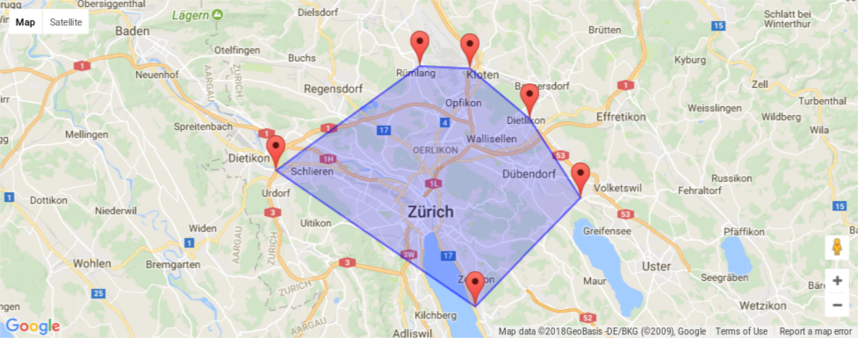
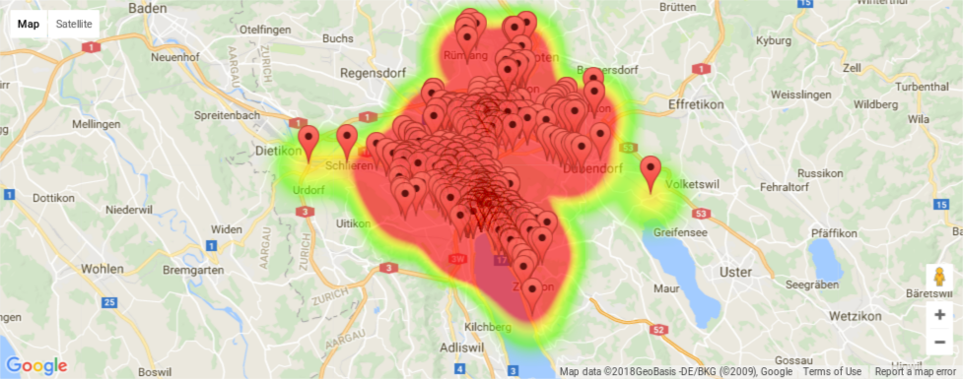
Visualization

Slide 14
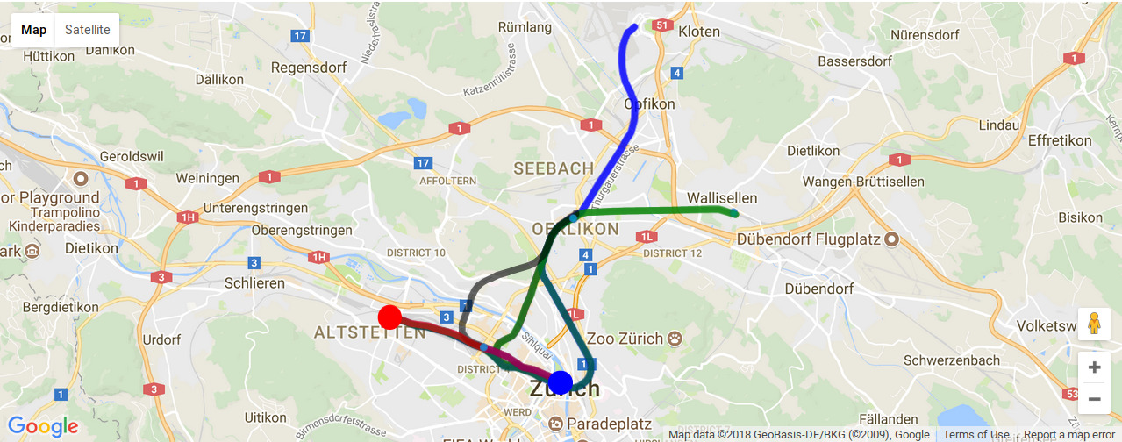
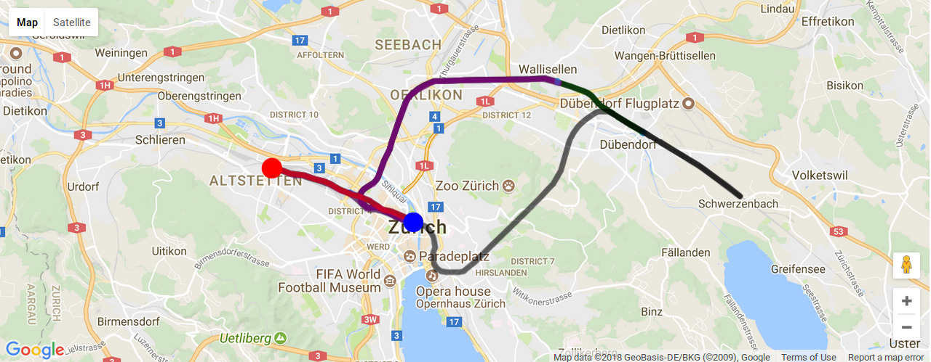

Slide 15
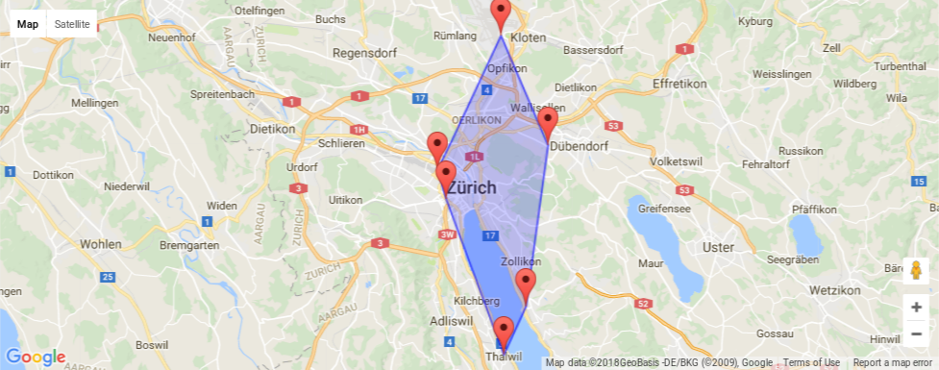
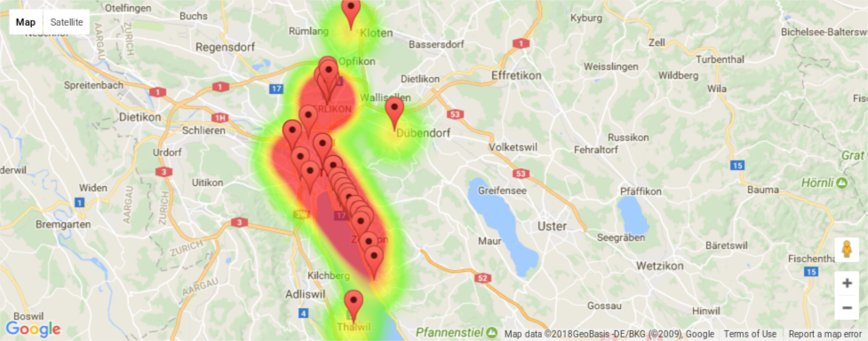
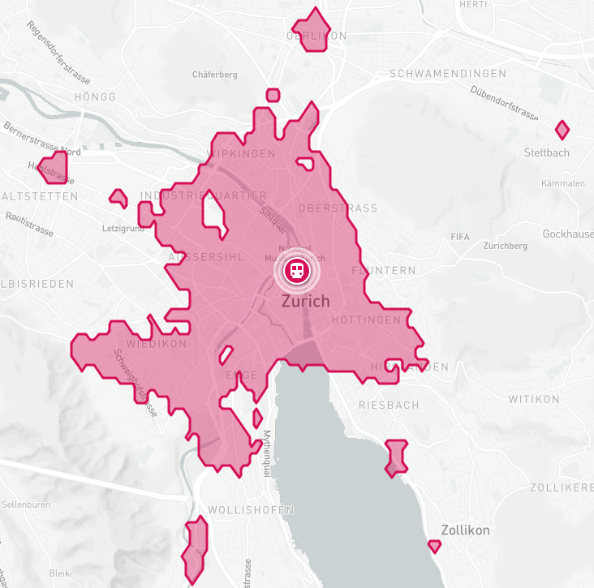
Validation

Slide 16
